Slide 1

FINAL PROJECT
Xiaoran Li NUID:001023070

Slide 2
How to Manage Your Money Better
In our daily life, people often find that they spend more than expected. And then, everyone will recall their past expenditures, but a large amount of expenditures will make it difficult for people to remember clearly, so how to record personal expenditure clearly and conveniently is a problem that needs to be solved. A clear record will help people control their expenditures, spend their money on more meaningful things, and avoid unconsciously overspending in some areas.
On the other hand, everyone has their own group of close friends or co-renting partners. In this case, sometimes a lot of public expenses (partying and traveling etc.) need to be shared by everyone. It would be a waste of time if every public expenditure has to be settled once, so if everyone can record public expenditures to the same ledger and settle them regularly, it will make life in groups easier.
So I decided to make a ledger app, which can not only record personal income and expenditure to help people manage their own money better, but also create a group ledger to simplify the transfer steps.

Slide 3
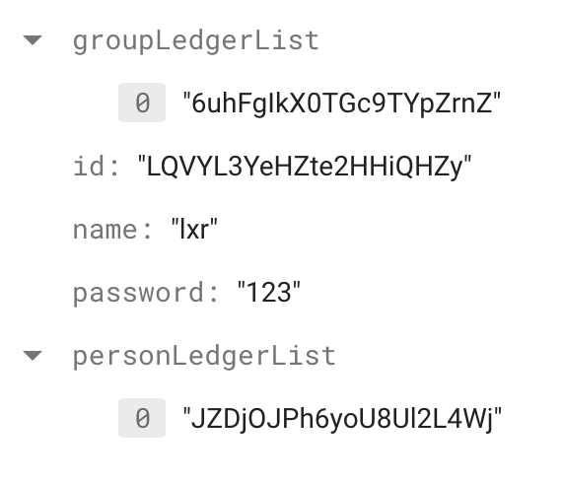
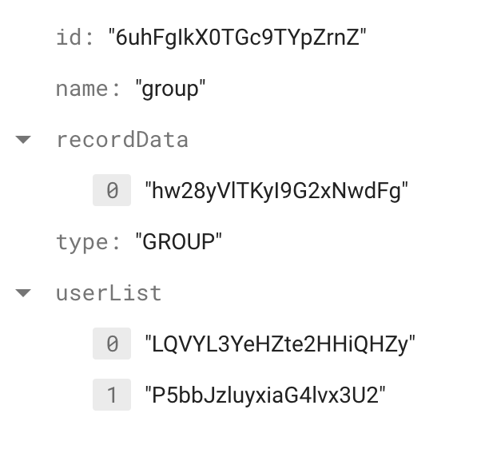
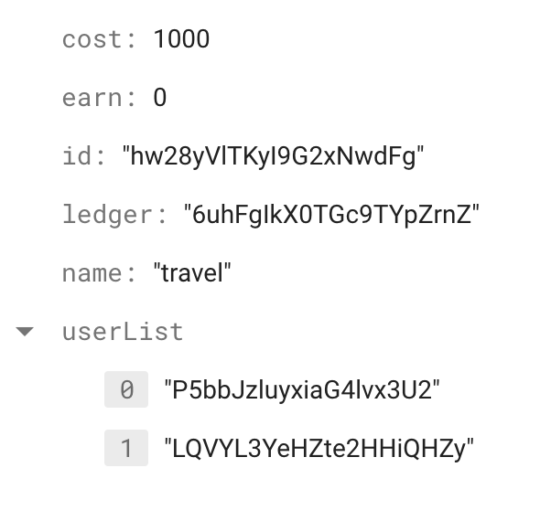
Design Pattern
User:
Ledger:
Record:

Slide 4
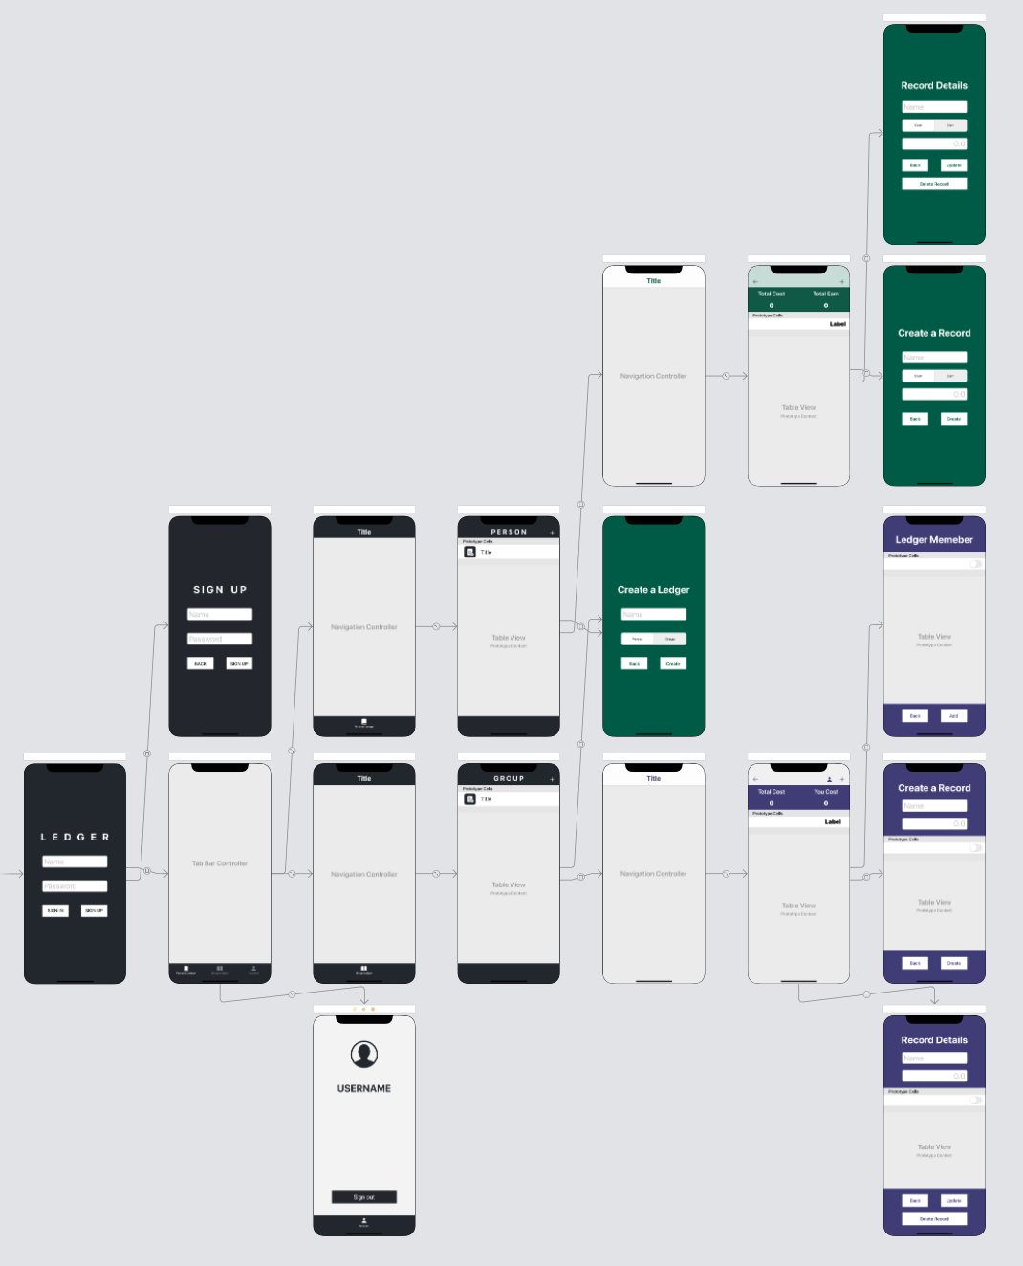
Design Pattern
Implement functions:
sign up
sign in
sign out
personal ledger (create, update, delete, view)
group ledger (create, update, delete, view)
add group ledger member
person record (create, update, delete, view)
group record (create, update, delete, view)
Server part:
all data is retrieve from server in the realtime
Structure:

Slide 5
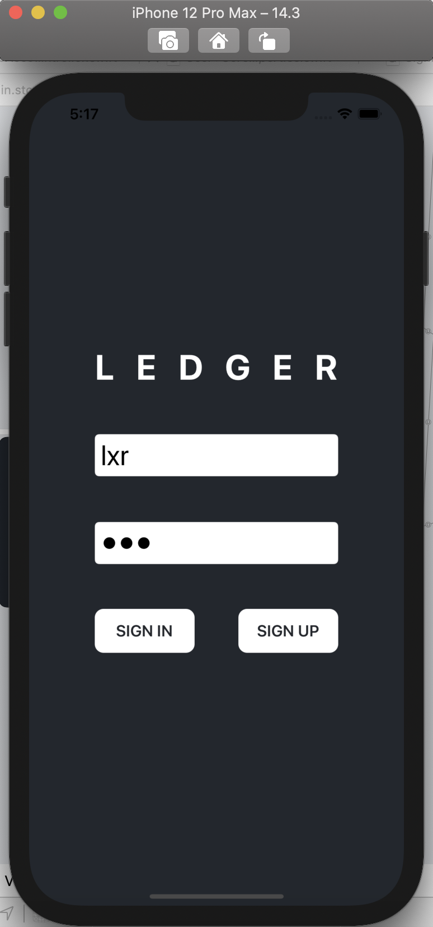
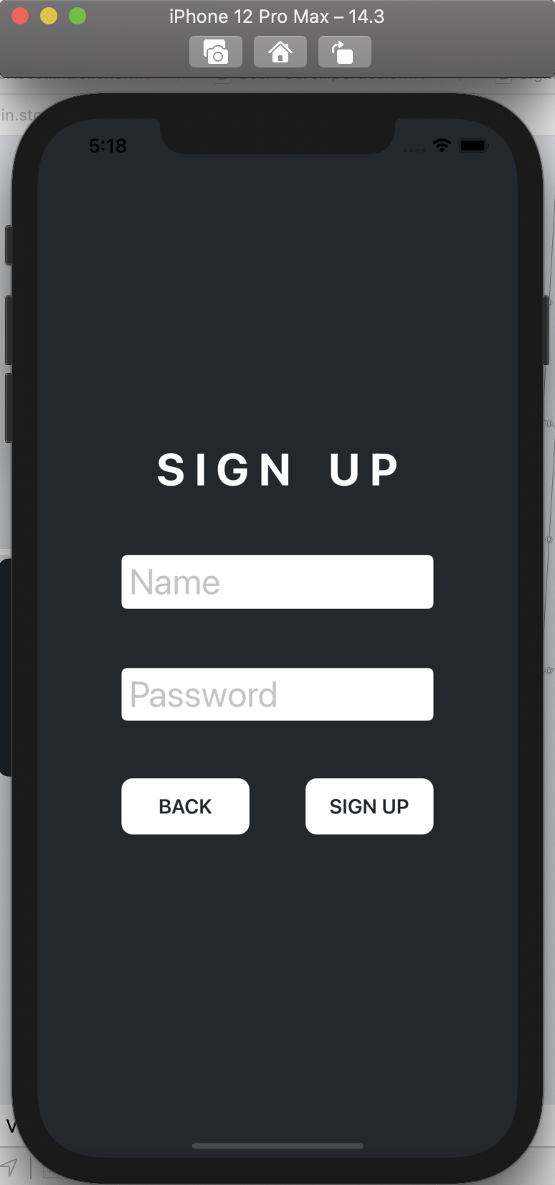
App Flow

Slide 6
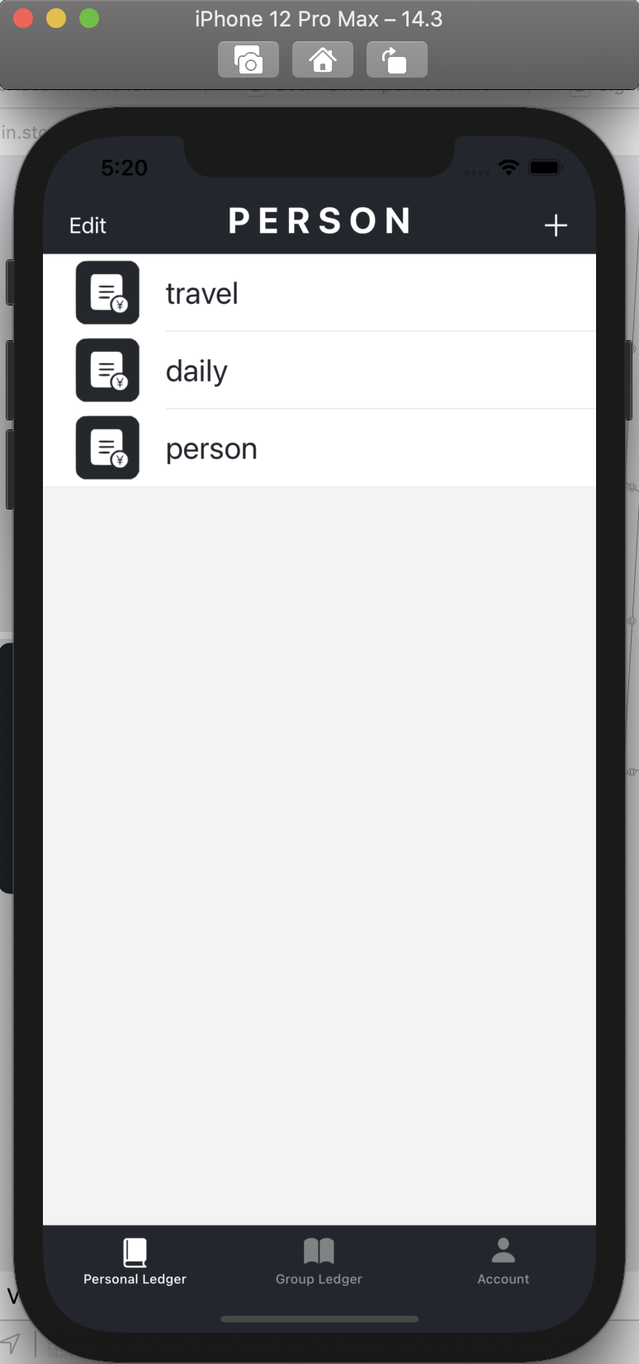
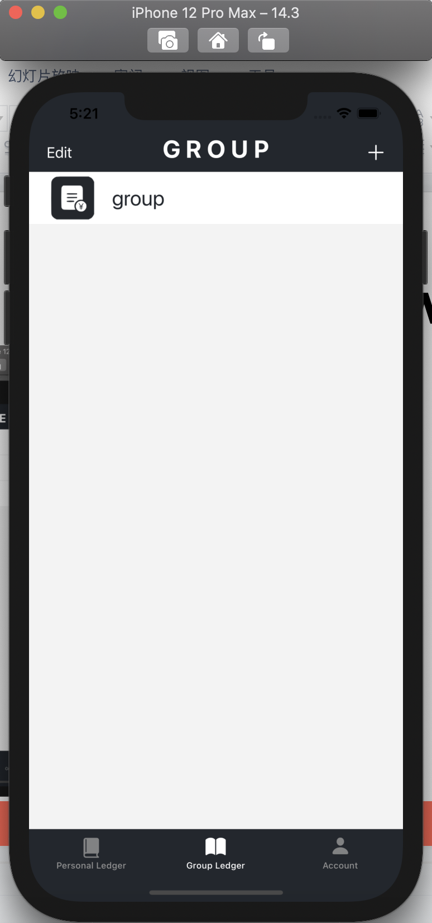
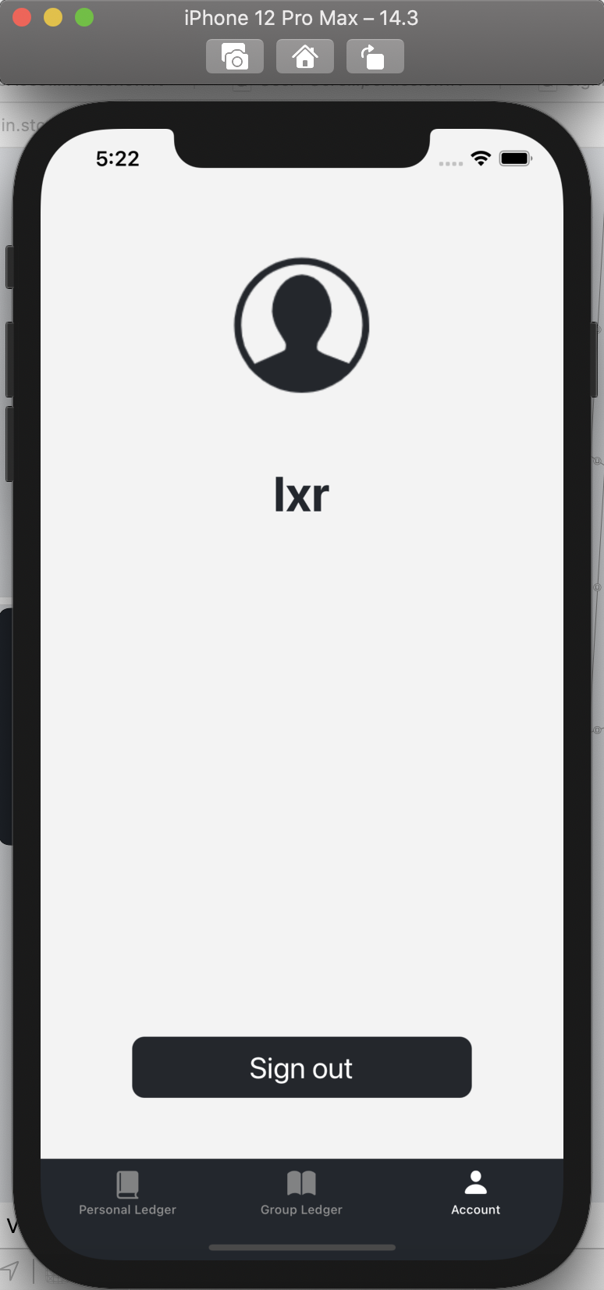
App Flow

Slide 7
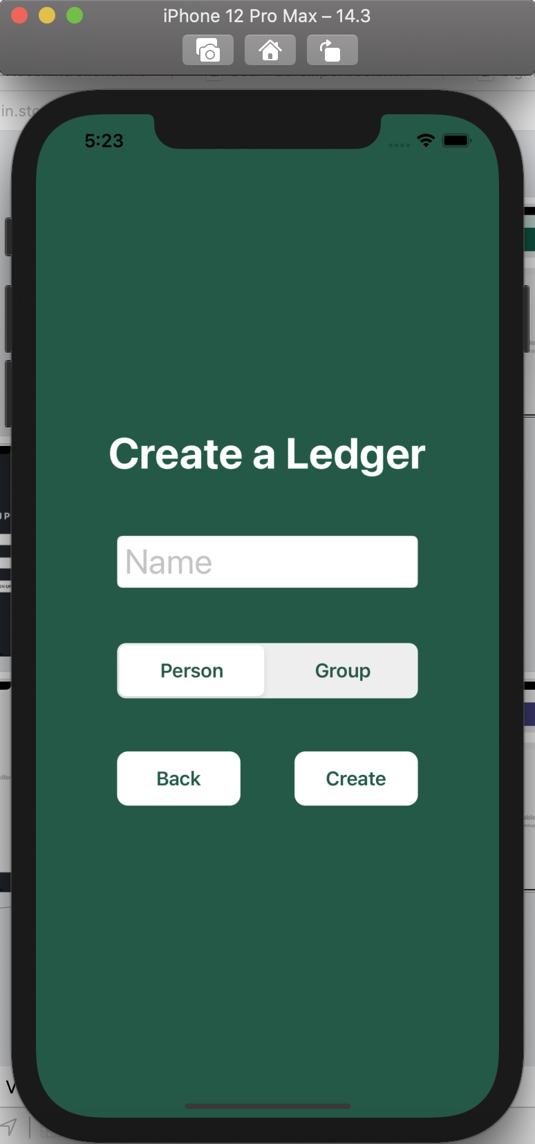
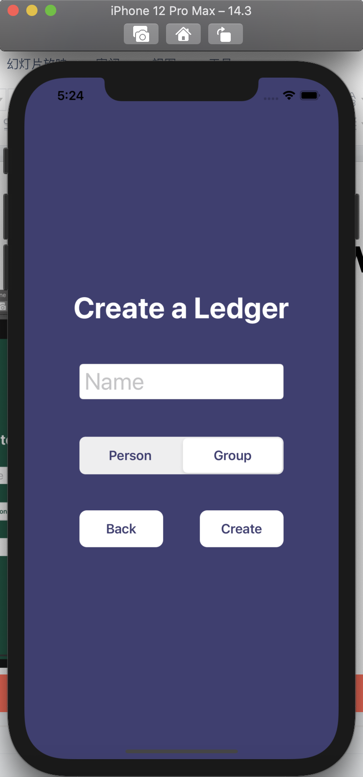
App Flow

Slide 8
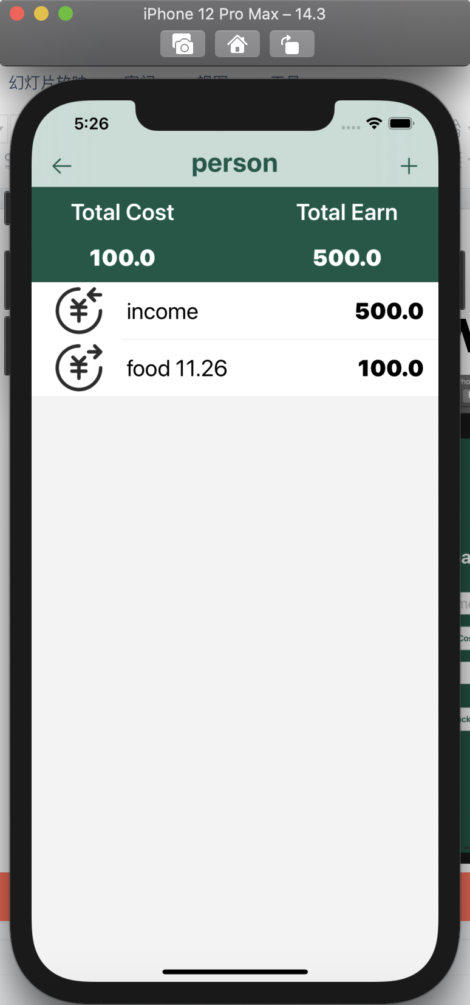
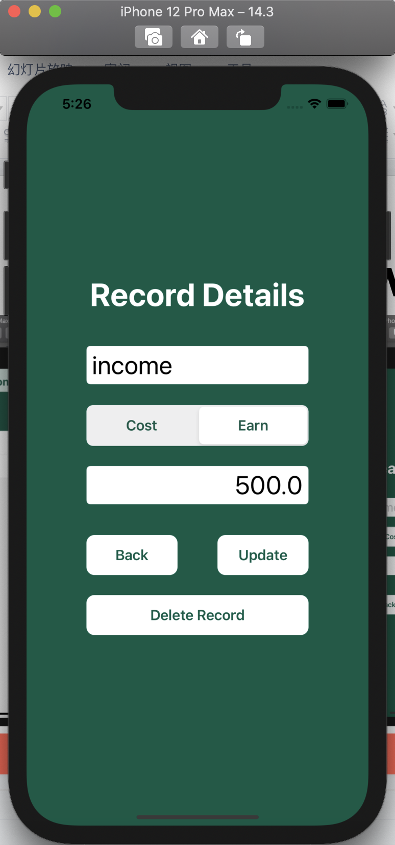
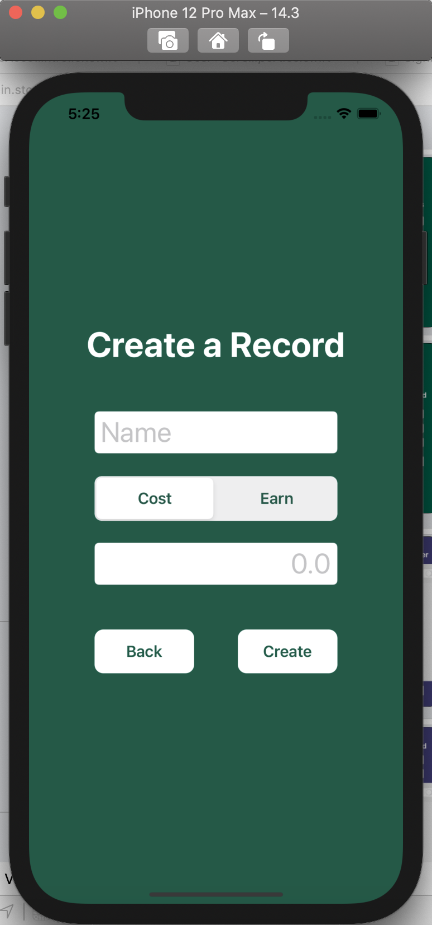
App Flow

Slide 9
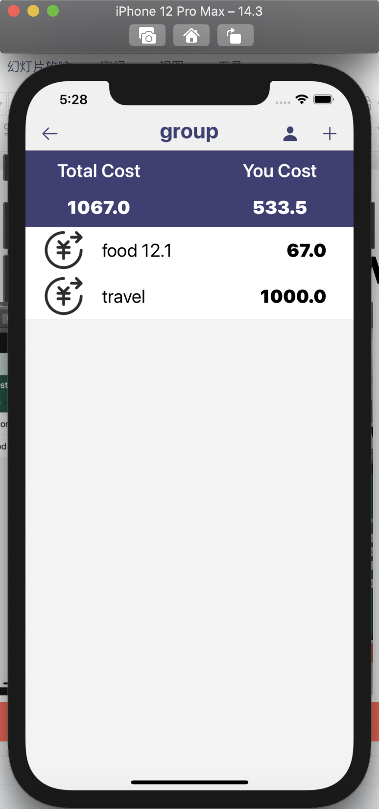
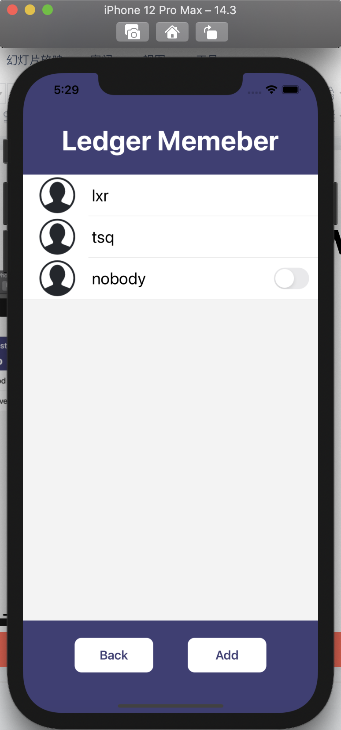
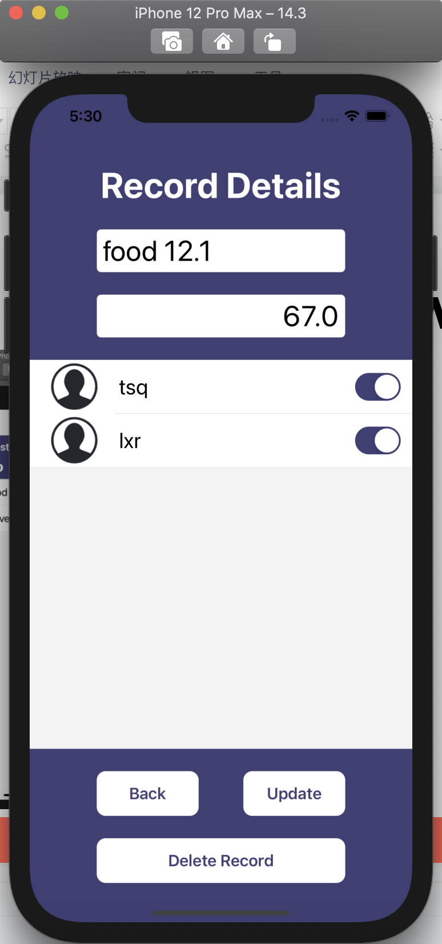
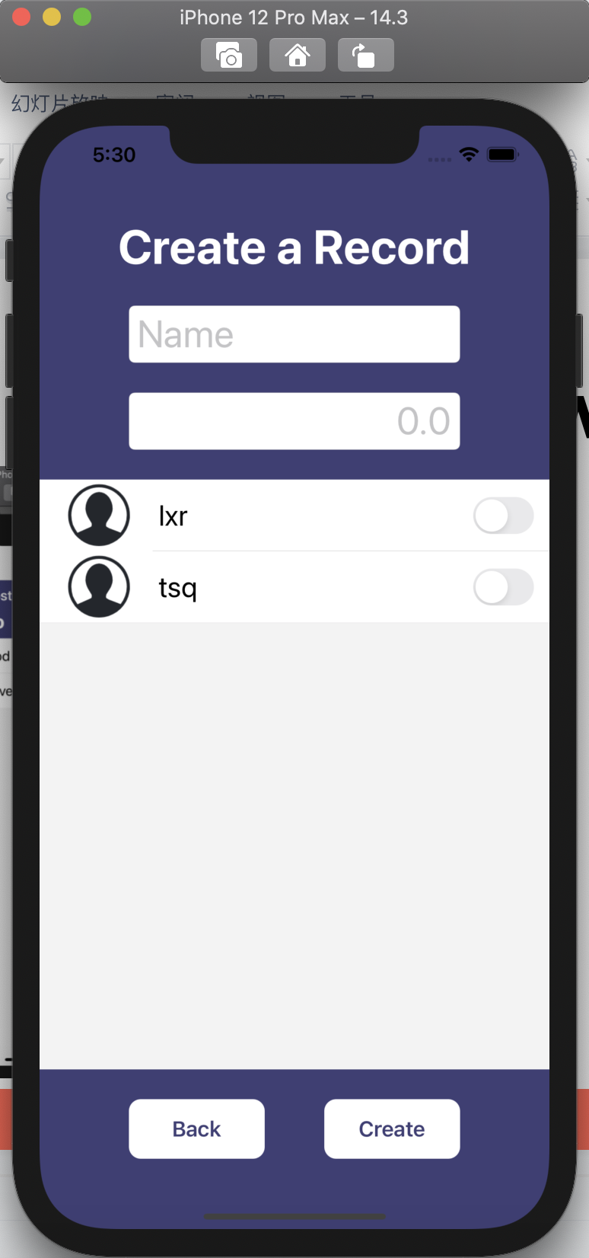
App Flow

Slide 10
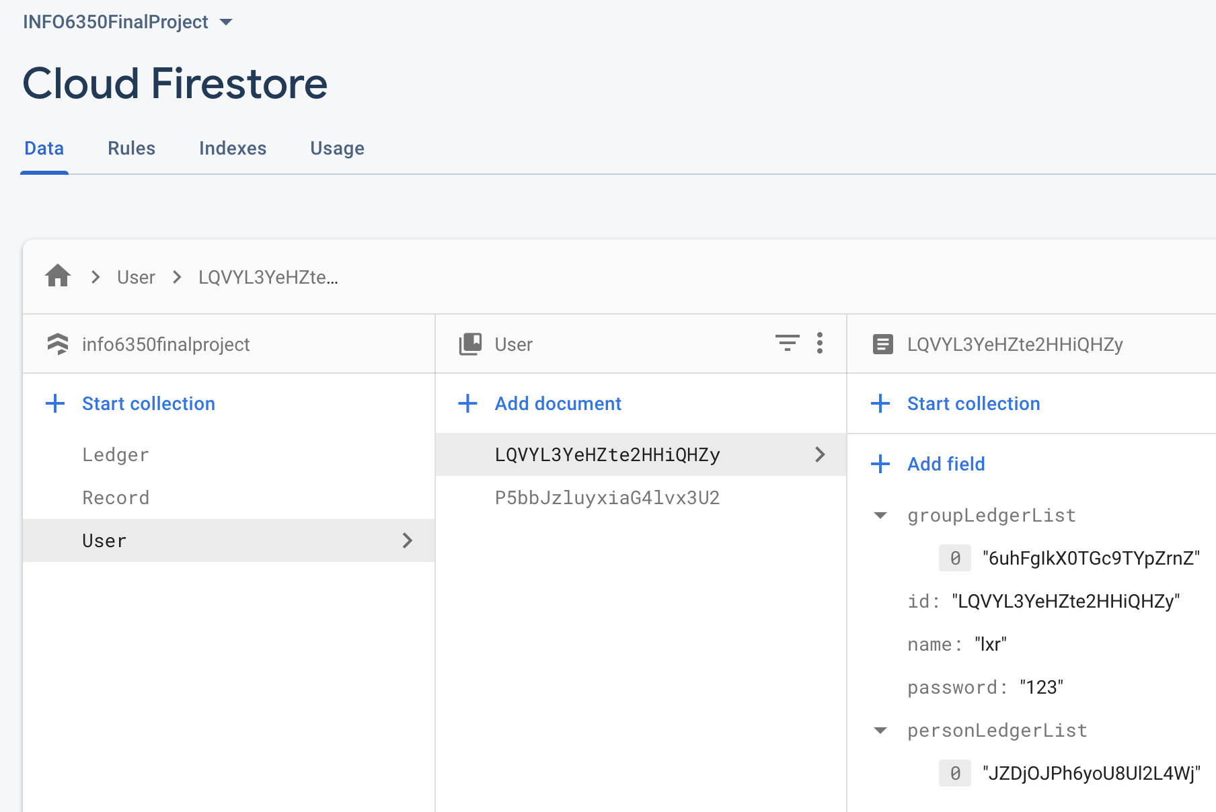
Techniques
UI part:
Segment controller
UIswitch
Server part:
Firebase -> Firestore
Advantages:
Comfortable UI appearance
Displays fine on different iPhone models

Slide 11
Future Enhancement
Add member to group ledger should send a invitation to others, and only the invitation is accepted, the group ledger can add the record includes new member.
The group ledger can have a record to store the amount that each user have paid.
The group ledger can have a liquidation function to auto-calculate the amount that each user should transfer to others.
The group ledger can have a reset function to delete all records, so that user do not need to add a new group ledger and invite members again after each liquidation.

